Slide 1

Modelling and Simulation of Surface Run- off patterns in Hydrological Cycle, DA-IICT
Group 1
SC209
Environmental Studies

Slide 2
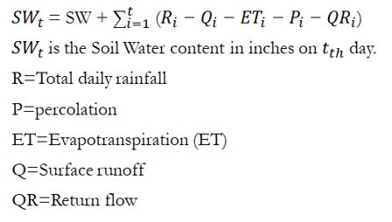
Introduction to Hydrological Cycle
Hydrological cycle describes the continuous movement of water on, above and below the surface of the Earth. It is one that shapes the rate of growth and determines the nature of lifeforms pertaining to an ecosystem. It majorly consists of:
1) Precipitation
2) Surface Runoff
3) Lateral Subsurface Flow
4) Evaporation
5) Transpiration and Plants Uptake
6) Percolation
The hydrological cycle's essence lies in the Water Balance Equation
The aim of today's presentation is to model the hydrological cycle. The objective being, with the information, we would be able to implement best rainwater management practices at DA-IICT.

Slide 3
Introduction to the Project
In this project, we model Surface Runoff in Hydrological Cycle, DA-IICT.
The Surface Water runoff - generation process, is highly complex, nonlinear, dynamic in nature, and is affected by many interrelated physical factors. Further, the temporally and spatially variable nature of these factors, causes more uncertainty in the parameterization of the model.
Surface runoff is a major component of the water cycle. It is the primary agent in soil erosion by water. This type of runoff appears in the hydrograph after the initial demands of interception, infiltration, and surface storage have been satisfied. It is our aim to minimize the surface runoff in DA-IICT.
SWRRB stands for Simulator for Water resources in rural basins, which is such a model, that was developed for simulating hydrological and related processes. This model was developed to mathematically simulate various factions of the hydrological cycle.
Surface Runoff is modelled using one specific technique that is part of the SWRRB Model, called the Curve Number Technique. The curve number technique relates runoff to soil type, land use and management practices. It is also reliable and computationally efficient.

Slide 4
Modelling of precipitation
First of all, we have to procure the data of rainfall at DA-IICT. We obtain the daily rainfall amounts from different measuring stations. The objective is to use these various data points and apply geostatic analysis techniques to measure rainfall at different locations within the campus.
The daily data of rainfall amounts was obtained from these stations:
Sanand
Ahmedabad
Khedbrahma
For each measuring station, we plotted the recorded amounts of daily rainfall for 4 months – June, July, August and September from 2009-2018. Thus, we can have a max of 122 x 10 = 1220 data points for each station.
We aimed to find the envelope of the curve for this data set (daily rainfall amount vs. time) and applying time-scale prediction techniques (LSTM), predict the daily rainfall for DA-IICT, accounting for both temporal and spatial variations. This was done for all the stations and we took the appropriate contributions from each. By this, we were able to predict how much rainfall would be expected on which day and thereby, correctly estimate runoff from different locations at different times.

Slide 5
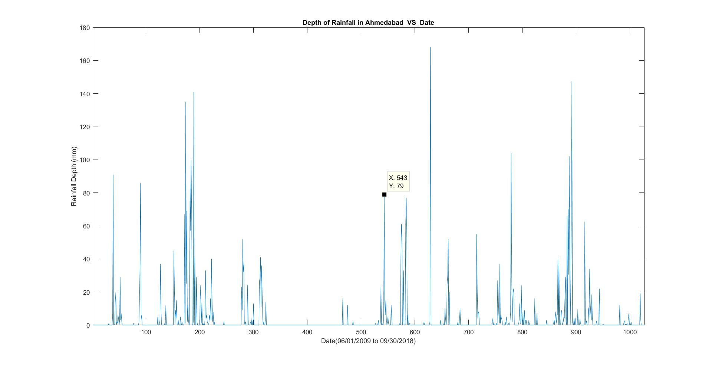

Slide 6
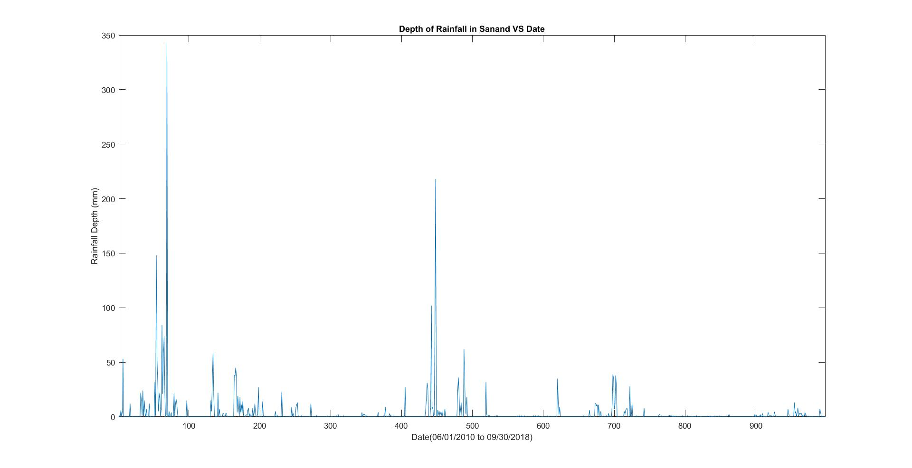

Slide 7
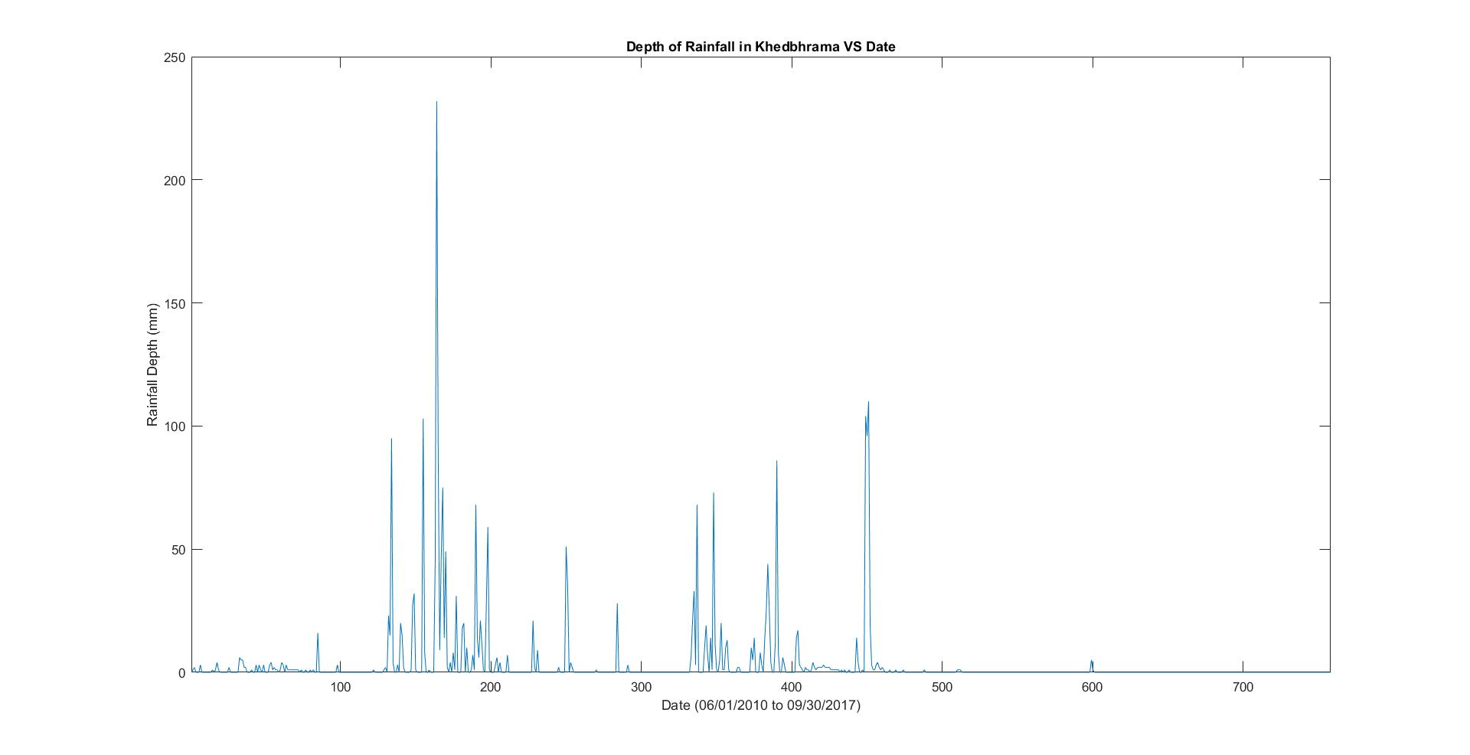

Slide 8
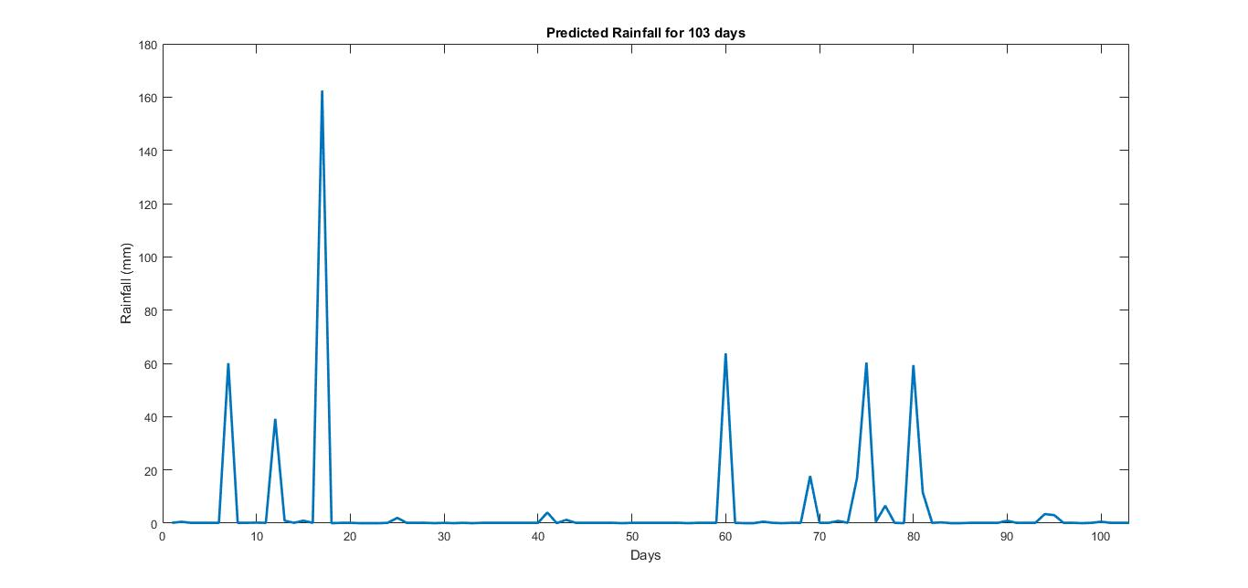

Slide 9
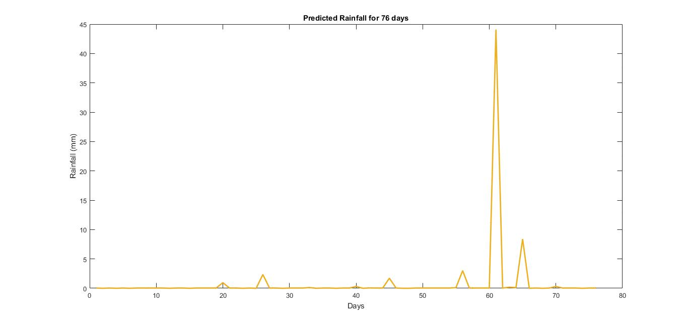

Slide 10
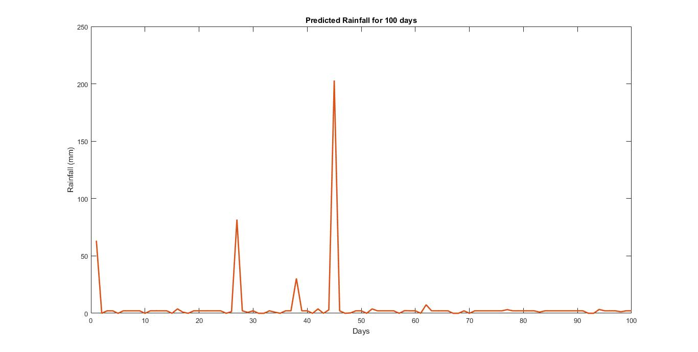

Slide 11
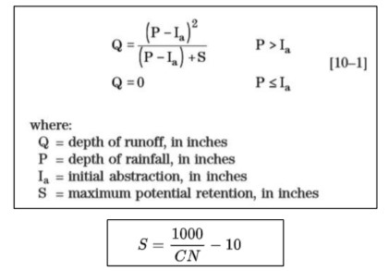
Soil Conservation Service (SCS) Curve Number Technique.
CN generally has a range from 30 to 100
Note that, here we made an experimental assumption that the initial abstraction of water by the plants, is 0.2S, which has been found to hold good in multiple practical scenarios.

Slide 12
Curve Number
Curve number indicates runoff potential of land area, I.e., higher the CN, more is tendency of Runoff.
Index Allotted | Kind of terrain | Hydrologic Soil Group | Curve Numbers (CN-II)
1 | Café (Outer) | A | 74
2 | Open Lawns | B | C | 67.5
3 | Roads | B | 98
4 | Pavements | C | 89
5 | Shrubbery | B | 58
6 | Impervious | A | B | C | D | 98
For each of the above areas, we estimated the corresponding Hydrologic Soil Group, the pattern of Land-use, the kind of vegetation, and thereby, obtained the CN values for each zone.

Slide 13
Geometrical Analysis:
We obtained the map of DA-IICT and the measuring stations, using google maps and joined the three measuring points to the approximate geometrical Centre of the campus.
We then joined the adjacent measuring stations, thereby obtaining 3 triangles. The medians of the triangles formed, helped us to divide the campus of DA-IICT, into 3 triangular zones, such that they can be modelled by rainfall corresponding to the rainfall data of the three corresponding stations.
We find the geometrical areas of various establishments on campus, for each of the sector.
Sector 1 | Ahmedabad | Shrubbery, Pavement, Roads, Impervious (All LTs, Faculty Block1, RC B block, DA-IICT Power Supply), Complete Lab, Lotus Point, Lawns (While entering the Campus, Outside LTs)
Sector 2 | Sanand | Impervious (All hostels, A block of RC, SAC1, SAC2, OAT, CEP, Faculty Block 2,4, NAAC, Basketball court, Admin Block), Cafeteria, Playground (Lawn), Shrubbery, roads, pavements
Sector 3 | Khedbrahma | Campus Residency, Roads, Shrubbery, Bridge of RC

Slide 14
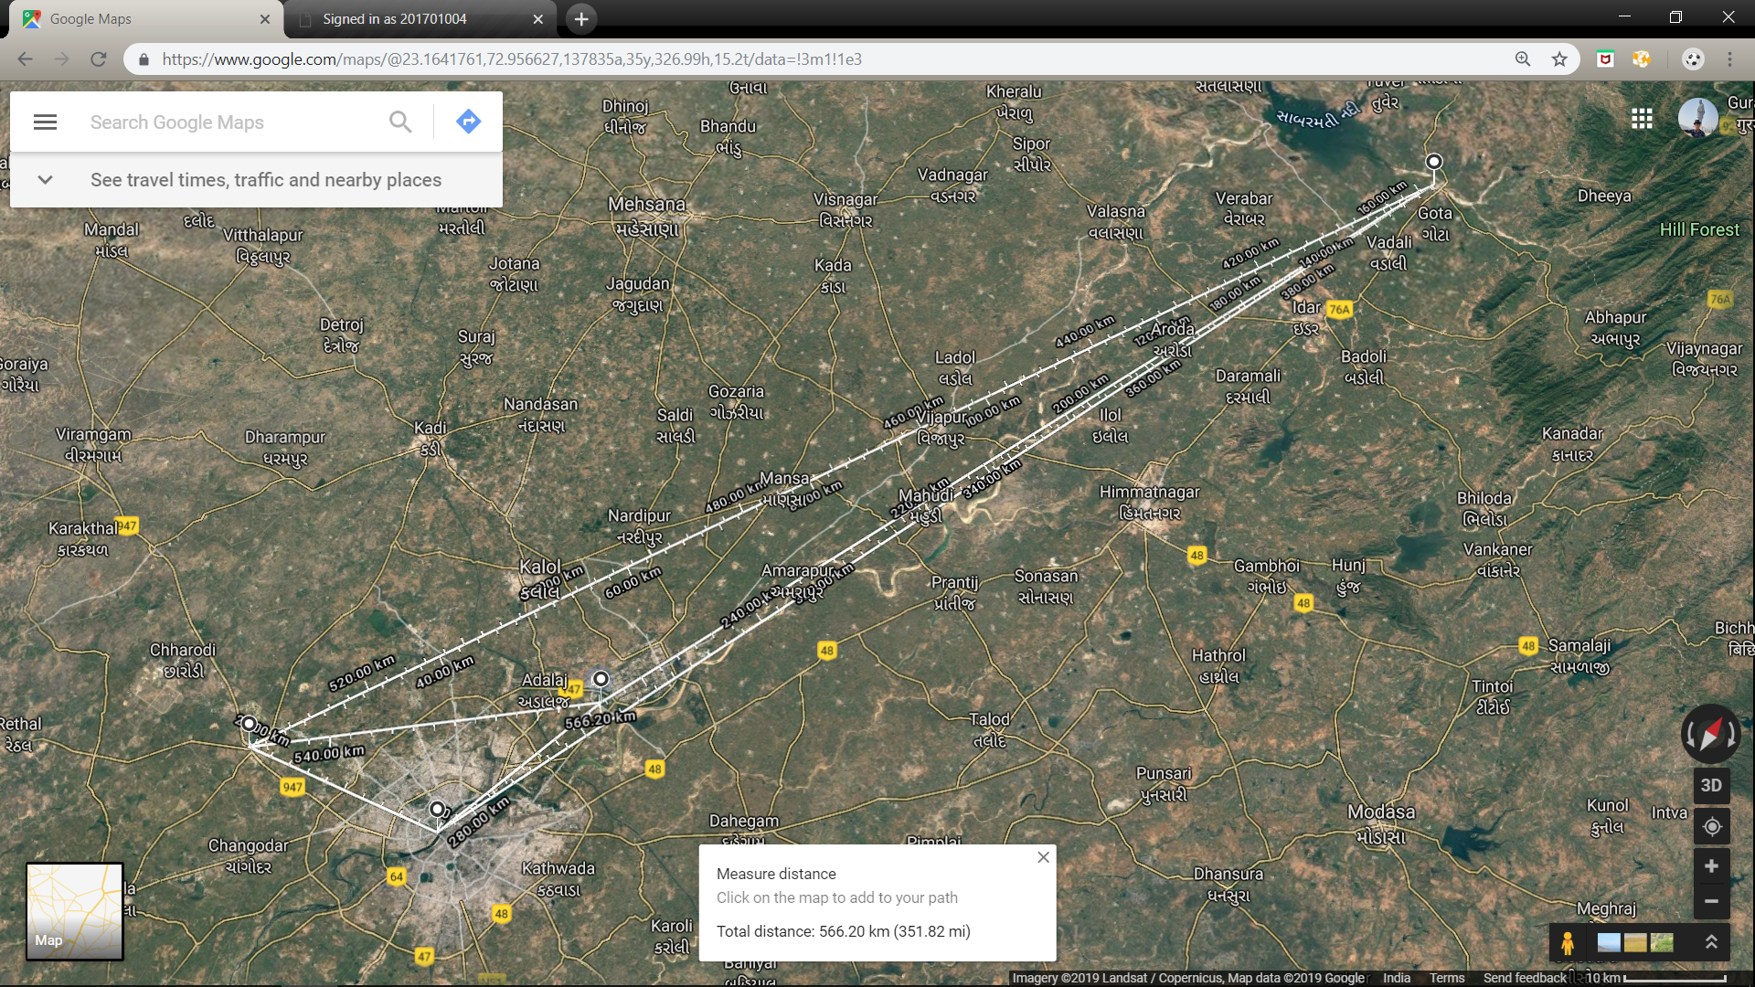
Khedbrahma
Sanand
Ahmedabad

Slide 16
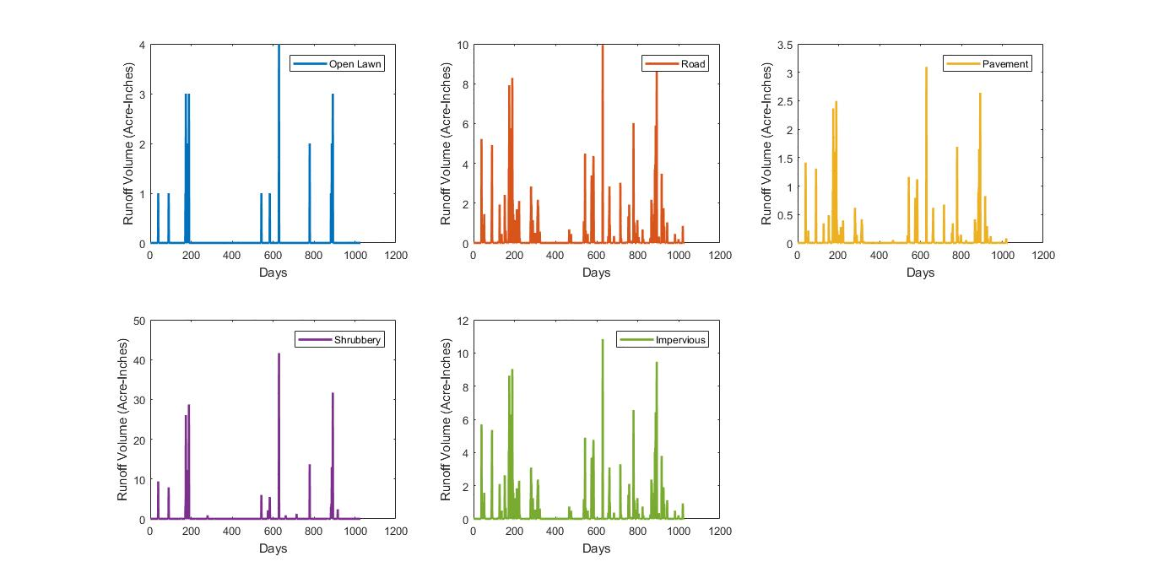
Modelling of Surface Run-Off
Using the existing data of rainfall for each of the 3 sectors and the corresponding topographical features, we computed Runoff volume for each kind of terrain in each sector, by multiplying the runoff depth with corresponding areas.
Ahmedabad

Slide 17
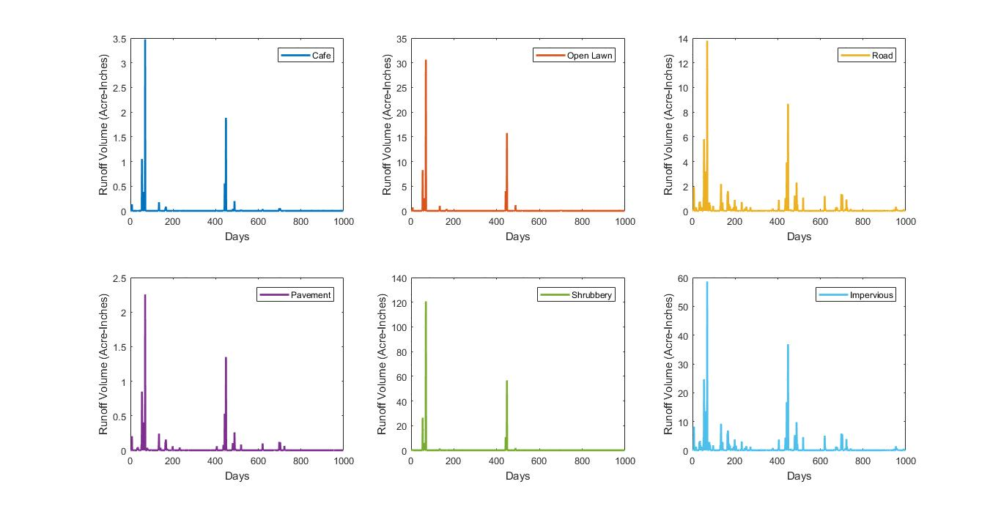
Sanand

Slide 18
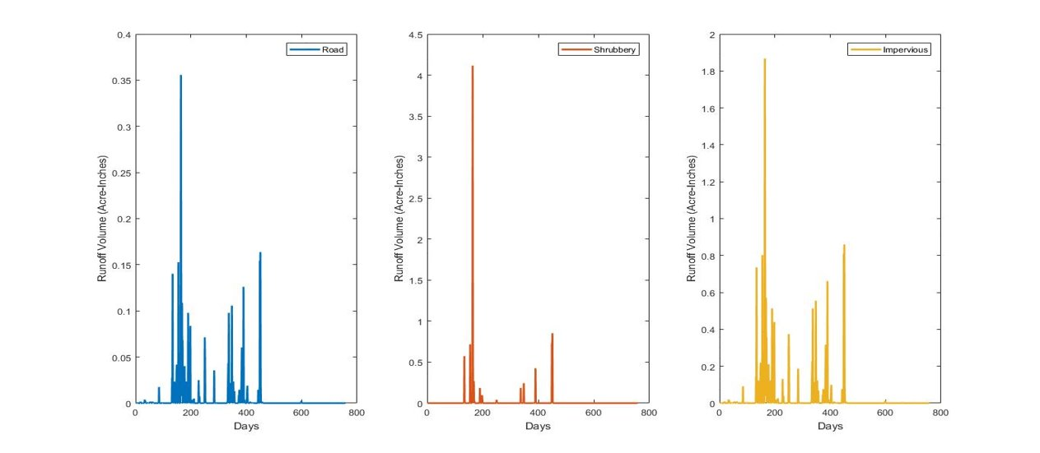
Khedbrahma

Slide 19
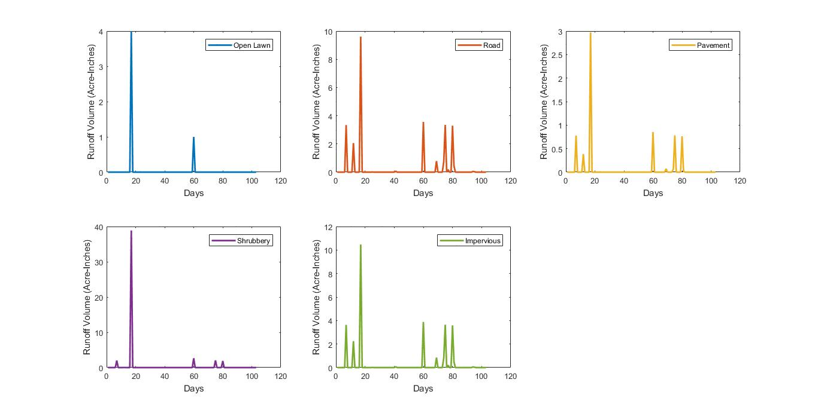
Using the predicted data of rainfall for each of the 3 sectors and the corresponding topographical features, we computed Runoff volume for each kind of terrain in each sector, by multiplying the runoff depth with corresponding areas.
Ahmedabad

Slide 20
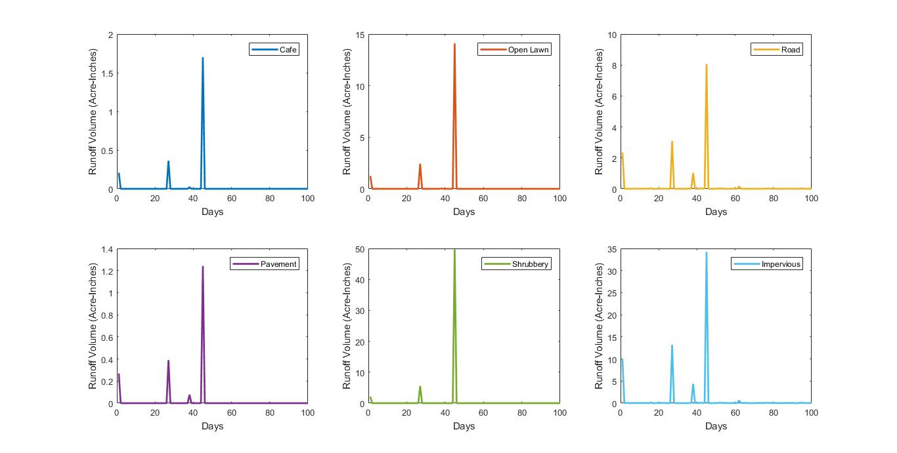
Sanand

Slide 21
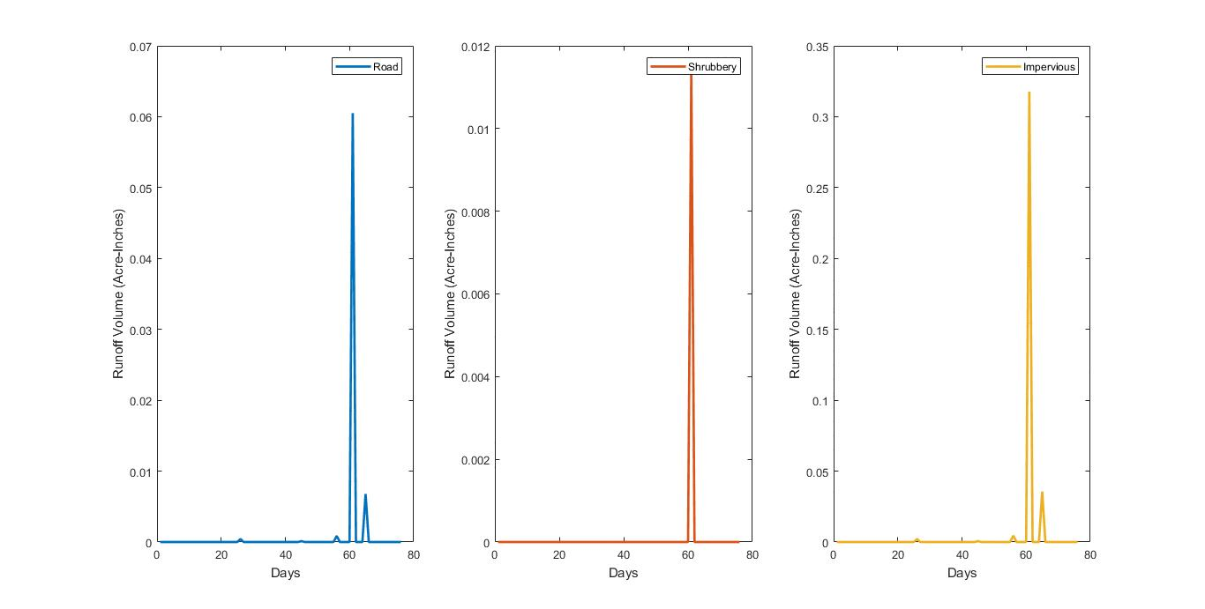
Khedbrahma

Slide 22
Modelling the flow of Surface Runoff
Having obtained the runoff depth, we obtained the volume of water runoff from each sector. Now, the water doesn’t run away uniformly, rather there is a formation of streams, which transports the water.
The runoff from various regions, lead to formation of streams. These streams form higher order streams and hence we get a network. There is an outflow point, I.e., a watershed region, where all the water goes through. We found out the direction of flow, by plotting a contour of the campus, using its elevation profile.
The elevation data as a function of latitude and longitude was obtained from Google Earth. The digital elevation model (DEM) was done using Surfer software.

Slide 23
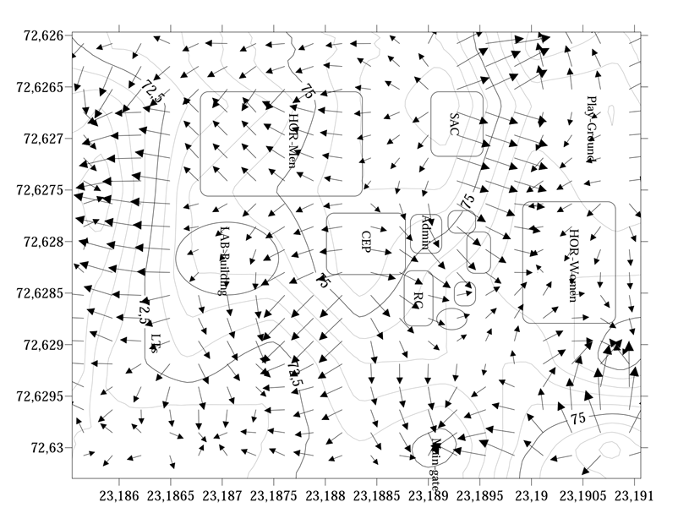

Slide 24
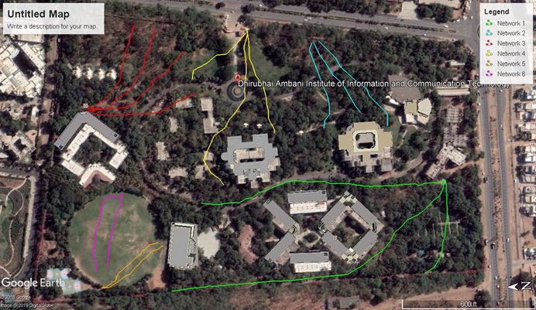
Finally, by approximating and joining the vectors of the flows, we obtain the network of streams of runoff in DA-IICT. This helps to determine the watershed regions, so that conservation practices can be applied at the appropriate locations.
The Runoff stream-flow network in DA-IICT

